Slide 1
Game AI/Game Engines 2 Pathfinding
Dr Bryan Duggan
Dublin Institute of Technology

Slide 2
What we will learn
What are graphs and what are they used for ?
How create navigation graphs
How to find the lowest cost path between two nodes in a graph using the A* algorithm

Slide 3
Path Finding
In computer games, it is necessary for characters to make decisions about how to get from A to B
This is easy for people, but requires intelligence to solve
For example, in RTS games, you click the mouse on a location on the map and the entity must figure out the most efficient way to get there:

Slide 4


Slide 5
Sometimes this might involve
Going over mountains (slower?)
Negotiating buildings
Negotiating bridges (or swimming?)
Climbing ladders
Opening doors
Moving other entities out of the way
In computer games, this is almost always achieved using the A* algorithm!

Slide 6
What is a graph?
Nodes
Connected by edges
Edges can be directed or undirected
An undirected graph is also known as a digraph

Slide 7
Graphs are also used for
State space searches
Technology trees
Dependency graphs

Slide 8
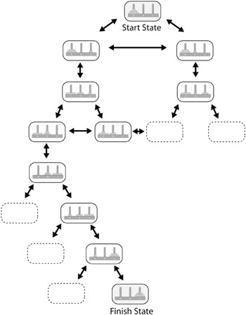
State Graphs
Consequently, these types of graphs are created and searched by expanding a few nodes at a time, typically (but not always) using algorithms that direct the search toward the goal state

Slide 9
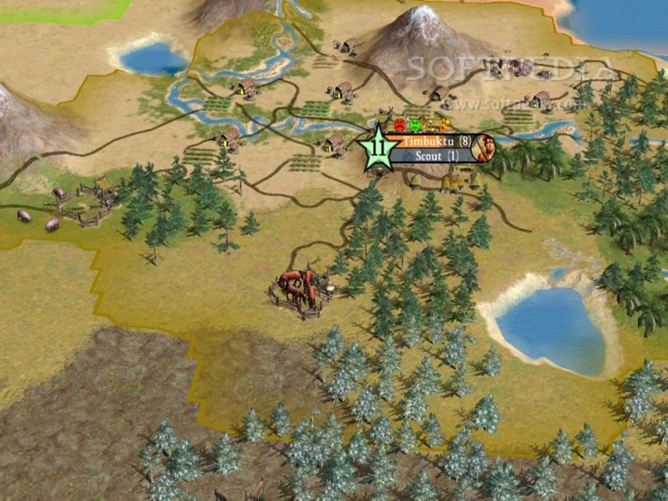

Slide 10
Graph Traversal
Depth first search
Exists – Use a stack to push edges
Breath first search – Use a queue
Least number of nodes
Dijkstra’s Algorithm
Lowest cost path to all other nodes
A*
Lowest cost path to a destination

Slide 11
template <class graph_type>
bool Graph_SearchDFS<graph_type>::Search()
{
//create a std stack of pointers to edges
std::stack<const Edge*> stack;
//create a dummy edge and put on the stack
Edge Dummy(m_iSource, m_iSource, 0);
stack.push(&Dummy);
//while there are edges on the stack keep searching
while (!stack.empty())
{
//grab the next edge
const Edge* Next = stack.top();
//remove the edge from the stack
stack.pop();
//make a note of the parent of the node this edge points to
m_Route[Next->To] = Next->From();
//and mark it visited
m_Visited[Next->To()] = visited;
//if the target has been found the method can return success
if (Next->To() == m_iTarget)
{
return true;
}
//push the edges leading from the node this edge points to onto
//the stack (provided the edge does not point to a previously
//visited node)
graph_type::ConstEdgeIterator ConstEdgeItr(m_Graph, Next->To());
for (const Edge* pE=ConstEdgeItr.begin();
!ConstEdgeItr.end();
pE=ConstEdgeItr.next())
{
if (m_Visited[pE->To()] == unvisited)
{
stack.push(pE);
}
}
}//while
//no path to target
return false;
}

Slide 12
template <class graph_type>
bool Graph_SearchBFS< graph_type>::Search()
{
//create a std queue of pointer's edges
std::queue<const Edge*> Q;
//create a dummy edge and put on the queue
const Edge Dummy(m_iSource, m_iSource, 0);
Q.push(&Dummy);
//mark the source node as visited
m_Visited[m_iSource] = visited;
//while there are edges in the queue keep searching
while (!Q.empty())
{
//grab the next edge
const Edge* Next = Q.front();
Q.pop();
//mark the parent of this node
m_Route[Next->To()] = Next->From();
//exit if the target has been found
if (Next->To() == m_iTarget)
{
return true;
}
//push the edges leading from the node at the end of this edge
//onto the queue
graph_type::ConstEdgeIterator ConstEdgeItr(m_Graph, Next->To());
for (const Edge* pE=ConstEdgeItr.begin();
!ConstEdgeItr.end();
pE=ConstEdgeItr.next())
{
//if the node hasn't already been visited we can push the
//edge onto the queue
if (m_Visited[pE->To()] == unvisited)
{
Q.push(pE);
//the node is marked as visited here, BEFORE it is examined, because
//it ensures a maximum of N edges are ever placed in the queue,
// rather than E edges.
m_Visited[pE->To()] = visited;
}
}
}
//no path to target
return false;
}

Slide 13
What is A*?
A graph traversal algorithm
It lets you find the lowest cost path through a graph
Not always the same as:
The shortest path
the path with the fewest nodes

Slide 14
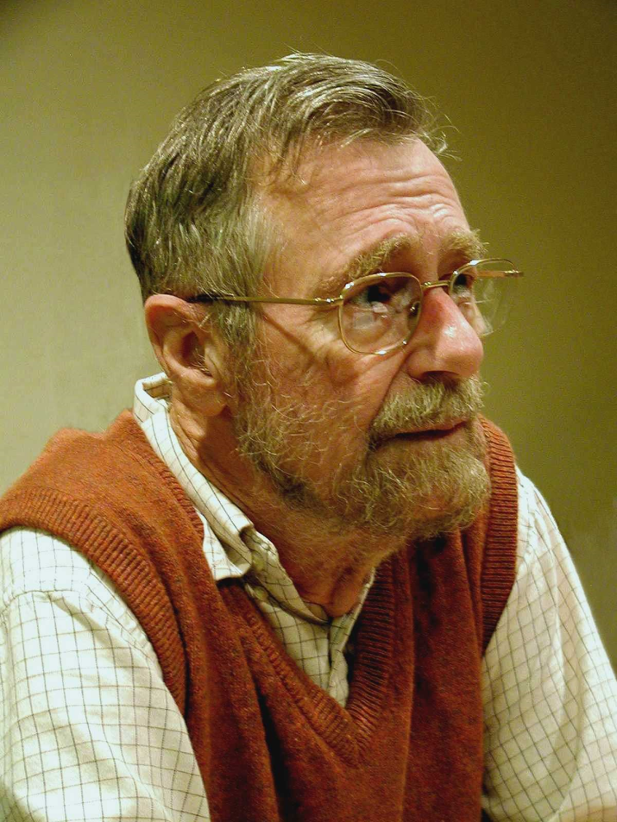
Edsger Wybe Dijkstra
“The question of whether computers can think is rather like the question of whether submarines can swim”

Slide 15
In this course we will make an A* for a nav graph
A graph which shows navigable areas of the world
Also known as Euclidian graph
Many algorithms for constructing:
X-Y traversal
Flood fill
Triangulation

Slide 16
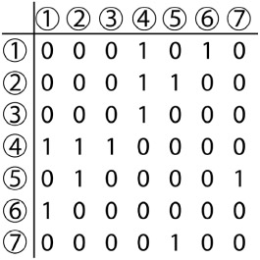
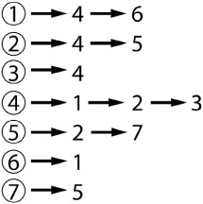
Representing graphs
adjacency matrix adjacency list

Slide 17
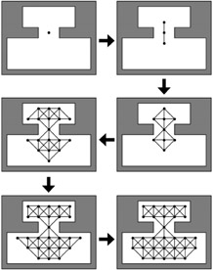
Flood fill

Slide 18
X-Y traversal
For each X
For each Y
If the node is navigable
Add to the graph

Slide 19
Triangulation using expanded geometry
Used in Unity3D pro nav mesh generation

Slide 20
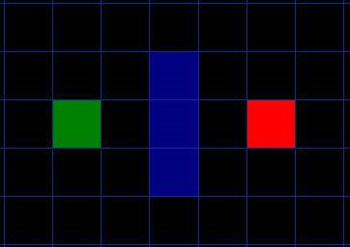
The A* Algorithm
Divide the search area into squares (nodes)
Nodes are connected to other nodes via edges
Green node is the source (A)
Red node is the destination (B)
Blue is a wall

Slide 21
General approach
Starting at point A
Checking the adjacent squares
Generally searching outward until we find our target.

Slide 22
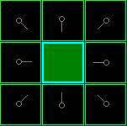
Start
Add A to the “open list” of squares to be considered.
The “open list” is a list of squares that need to be checked out.
Look at all the adjacent squares ignoring squares with walls, water, or other illegal terrain.
Add them to the open list, too. For each of these squares, save point A as its “parent square”.
Drop the starting square A from your open list, and add it to a “closed list” of squares that you don’t need to look at again for now.

Slide 23
Next…
Choose one of the adjacent squares on the open list repeat the earlier process, as described below.
But which square do we choose?
The one with the lowest F cost.

Slide 24
Path scoring
F = G + H
G = the movement cost to move from the starting point A to a given square on the grid, following the path generated to get there.
We will assign a cost of 10 to each horizontal or vertical square moved, and a cost of 14 for a diagonal move.
We use these numbers because the actual distance to move diagonally is the square root of 2, or 1.414 times the cost of moving horizontally or vertically. This way, we avoid having to calculate square roots
G cost of that square is to take the G cost of its parent, and then add 10 or 14
H = the estimated movement cost to move from that given square on the grid to the final destination, point B.
This is often referred to as the heuristic

Slide 25
Calculating H
3 Most used heuristics are:
Euclidian distance (length)
Manhattan distance (delta x + delta y + delta z) – in this case multiplied by 10
Distance squared (saves you having to do a square root calculation)

Slide 26
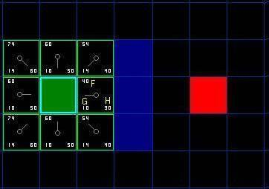
After 1 iteration
F
G
H

Slide 27
Continuing the search
Choose the lowest F score square from all those that are on the open list.
Drop it from the open list and add it to the closed list.
Check all of the adjacent squares. Ignoring those that are on the closed list or unwalkable (terrain with walls, water, or other illegal terrain), add squares to the open list if they are not on the open list already.
Make the selected square the “parent” of the new squares.
If an adjacent square is already on the open list, check to see if this path to that square is a better one. In other words, check to see if the G score for that square is lower if we use the current square to get there. If not, don’t do anything.
On the other hand, if the G cost of the new path is lower, change the parent of the adjacent square to the selected square
Finally, recalculate both the F and G scores of that square.

Slide 28
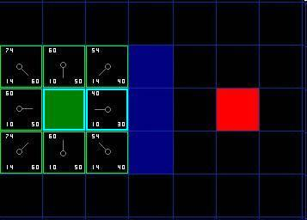

Slide 29
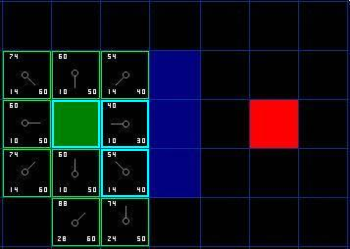

Slide 30
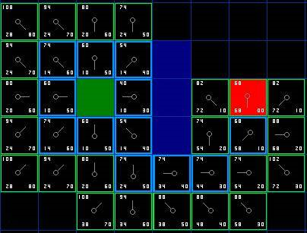

Slide 31
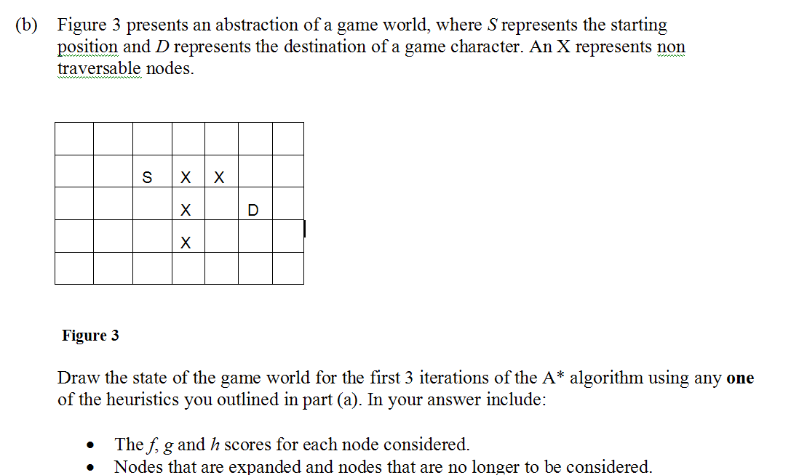

Slide 32
